Slide 1
eMaps
Fachpraktikum Algorithms on OpenStreetMap Data 19/20

Slide 2

Motivation
Electrically-powered vehicles important in fight against climate change
Unique characteristics:
Limited cruising range
Long recharge times
May run out of power
Adaption of route planners required!
Source

Slide 3
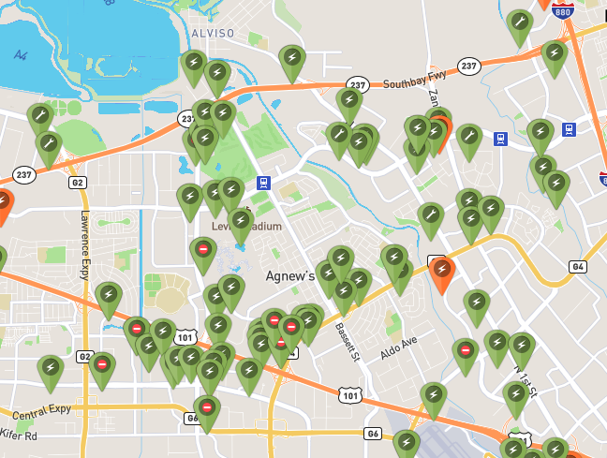
Idea
Route planner for e-Vehicles
Route planner should consider:
Current and maximum range of e-Vehicles
Availability of charging stations
Never running out of power
Source

Slide 4
Live Demo

Slide 5

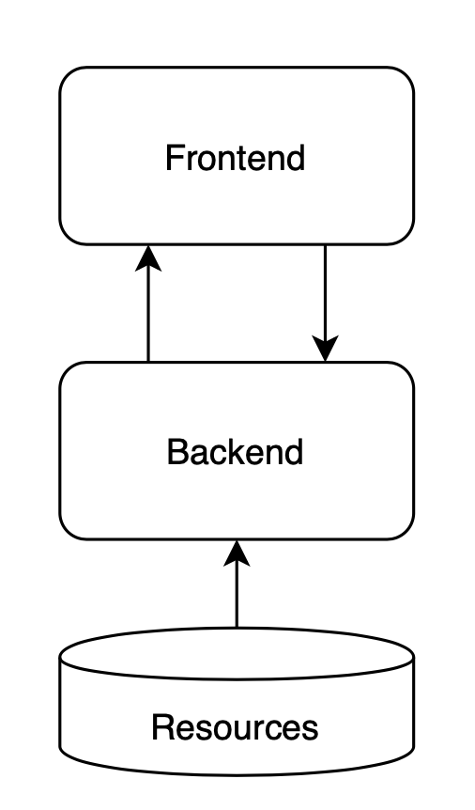



Architecture
Resources: Raw OpenStreetMap data in PBF format
Backend: core functionality and API written in Rust
Frontend: display map and routes using React and Leaflet
Source
Source
Source
Source

Slide 6
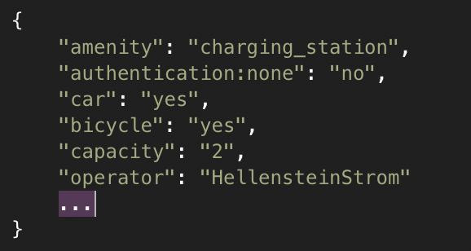
Key Concepts
Parse amenities from OpenStreetMap data with {amenity: charging_station}
Parse vehicle supported by charging station, e.g. only Cars, only Bikes, or both
Extend graph with charging station nodes

Slide 7
Key Concepts
Backend receives routing request from Frontend including current and maximum range of electric vehicle
Initial Dijkstra calculation to check if charging is required at all
No: return calculated dijkstra
Yes: go to 3
Identify "best" charging station related to start and goal and current range
Calculate Dijkstra from start to identified charging station
Set current range = maximum range and start = charging station
Calculate Dijkstra from charging station to goal to check if further charging is required:
No: concatenate route and return
Yes: continue with 3
Notes:
Anzahl Dijkstras per Request: ((ROUND_UP((gesamt distanz – aktuelle reichweite) / maximal reichweite )) * 2) + 1

Slide 8
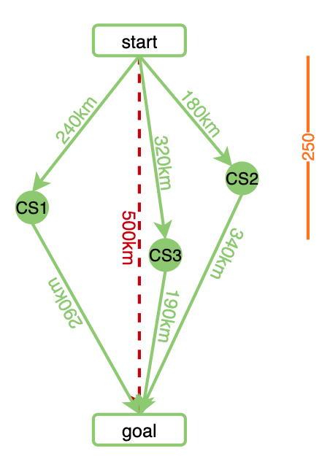
Key Concepts
For each charging station:
Check if haversine distance from start to charging station is within current range with treshold
Yes: go to 2
No: go to next charging station
Check if charging station utilizes at least 50% of current range
Yes: go to 3
No: go to next charging station
Calculate haversine distance from charging station to goal
Check if sum of distances is smaller than current best sum
Yes: update currently best charging station
No: go to next charging station

Slide 9
Key Concepts
CS1:
Is in current range: 240 < 250 true
Utilizes at least 50% of range: 240 => 250*0.5 true
Sum of distances smaller than current best sum: 290 + 240 < MAX true set as currently best charging station
CS2:
Is in current range: 320 < 250 false go to CS3
CS3:
Is in current range: 180 < 250 true
Utilizes at least 50% of range: 180 => 250*0.5 true
Sum of distances smaller than current best sum: 180 + 340 < 530 true set as currently best charging station

Slide 10
Other Features
Search Cities, Places, POIs, … via Nominatim API
Show map of all charging stations
Time/distance routing
Routing for eBike and eCar

Slide 11
Limitations & Future Work
Determining charging station/route not optimal
Calculate dijkstra for each charging station inefficient
Extend edges by a weight representing the energy consumption
Consider elevation profile to determine more energy efficient routes

Slide 12
Thank you!

